Slide 1
What common building material poses significant health risks?
Pressure Treated Wood
(Chromated Copper Arsenic)

Slide 2
Learning Objectives
Understand what CCA stands for and why it is widely being used
Understand what are the concerns with using CCA pressure treated wood lumber
Understand the natural form of arsenate
Understand where CCA is commonly found and how individuals are exposed to the toxin
Understand the mechanism of action and target of organ
Understand how the toxin is metabolized and eliminated from the body
Understand the components of care management to reduce the adverse events

Slide 3
Why this Topic?
To help others to understand risks assoicated with use and handling of lumber treated with CCA(chromated copper arsenate)
Notes:
BEN

Slide 4
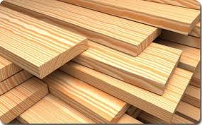
Wood

Slide 5
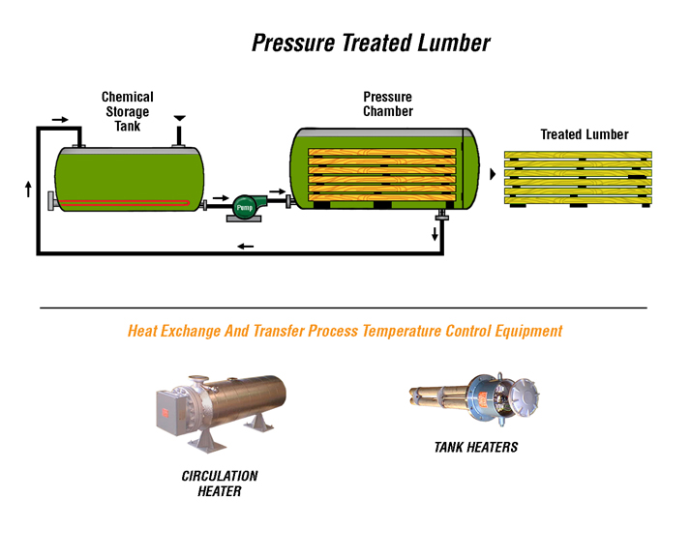
Pressure Treatment Method

Slide 6
Concerns
In February 2002, the U.S. Environmental Protection Agency (EPA) announced a voluntary phase-out by industry of most residential uses of this voluntary phase-out by industry of most residential uses.
Beginning in January 2004, CCA-treated wood can no longer be manufactured for decks and patios, picnic tables, playground manufactured for decks and patios, picnic tables, playground or fencing.
Notes:
BEN

Slide 7
CCA Treated lumber still exists in structures built before 2005.
All pressure treated lumber must be handled as toxic waste (can’t be disposed of in a landfill)
Warning lables at lumber yards
Notes:
BEN

Slide 8
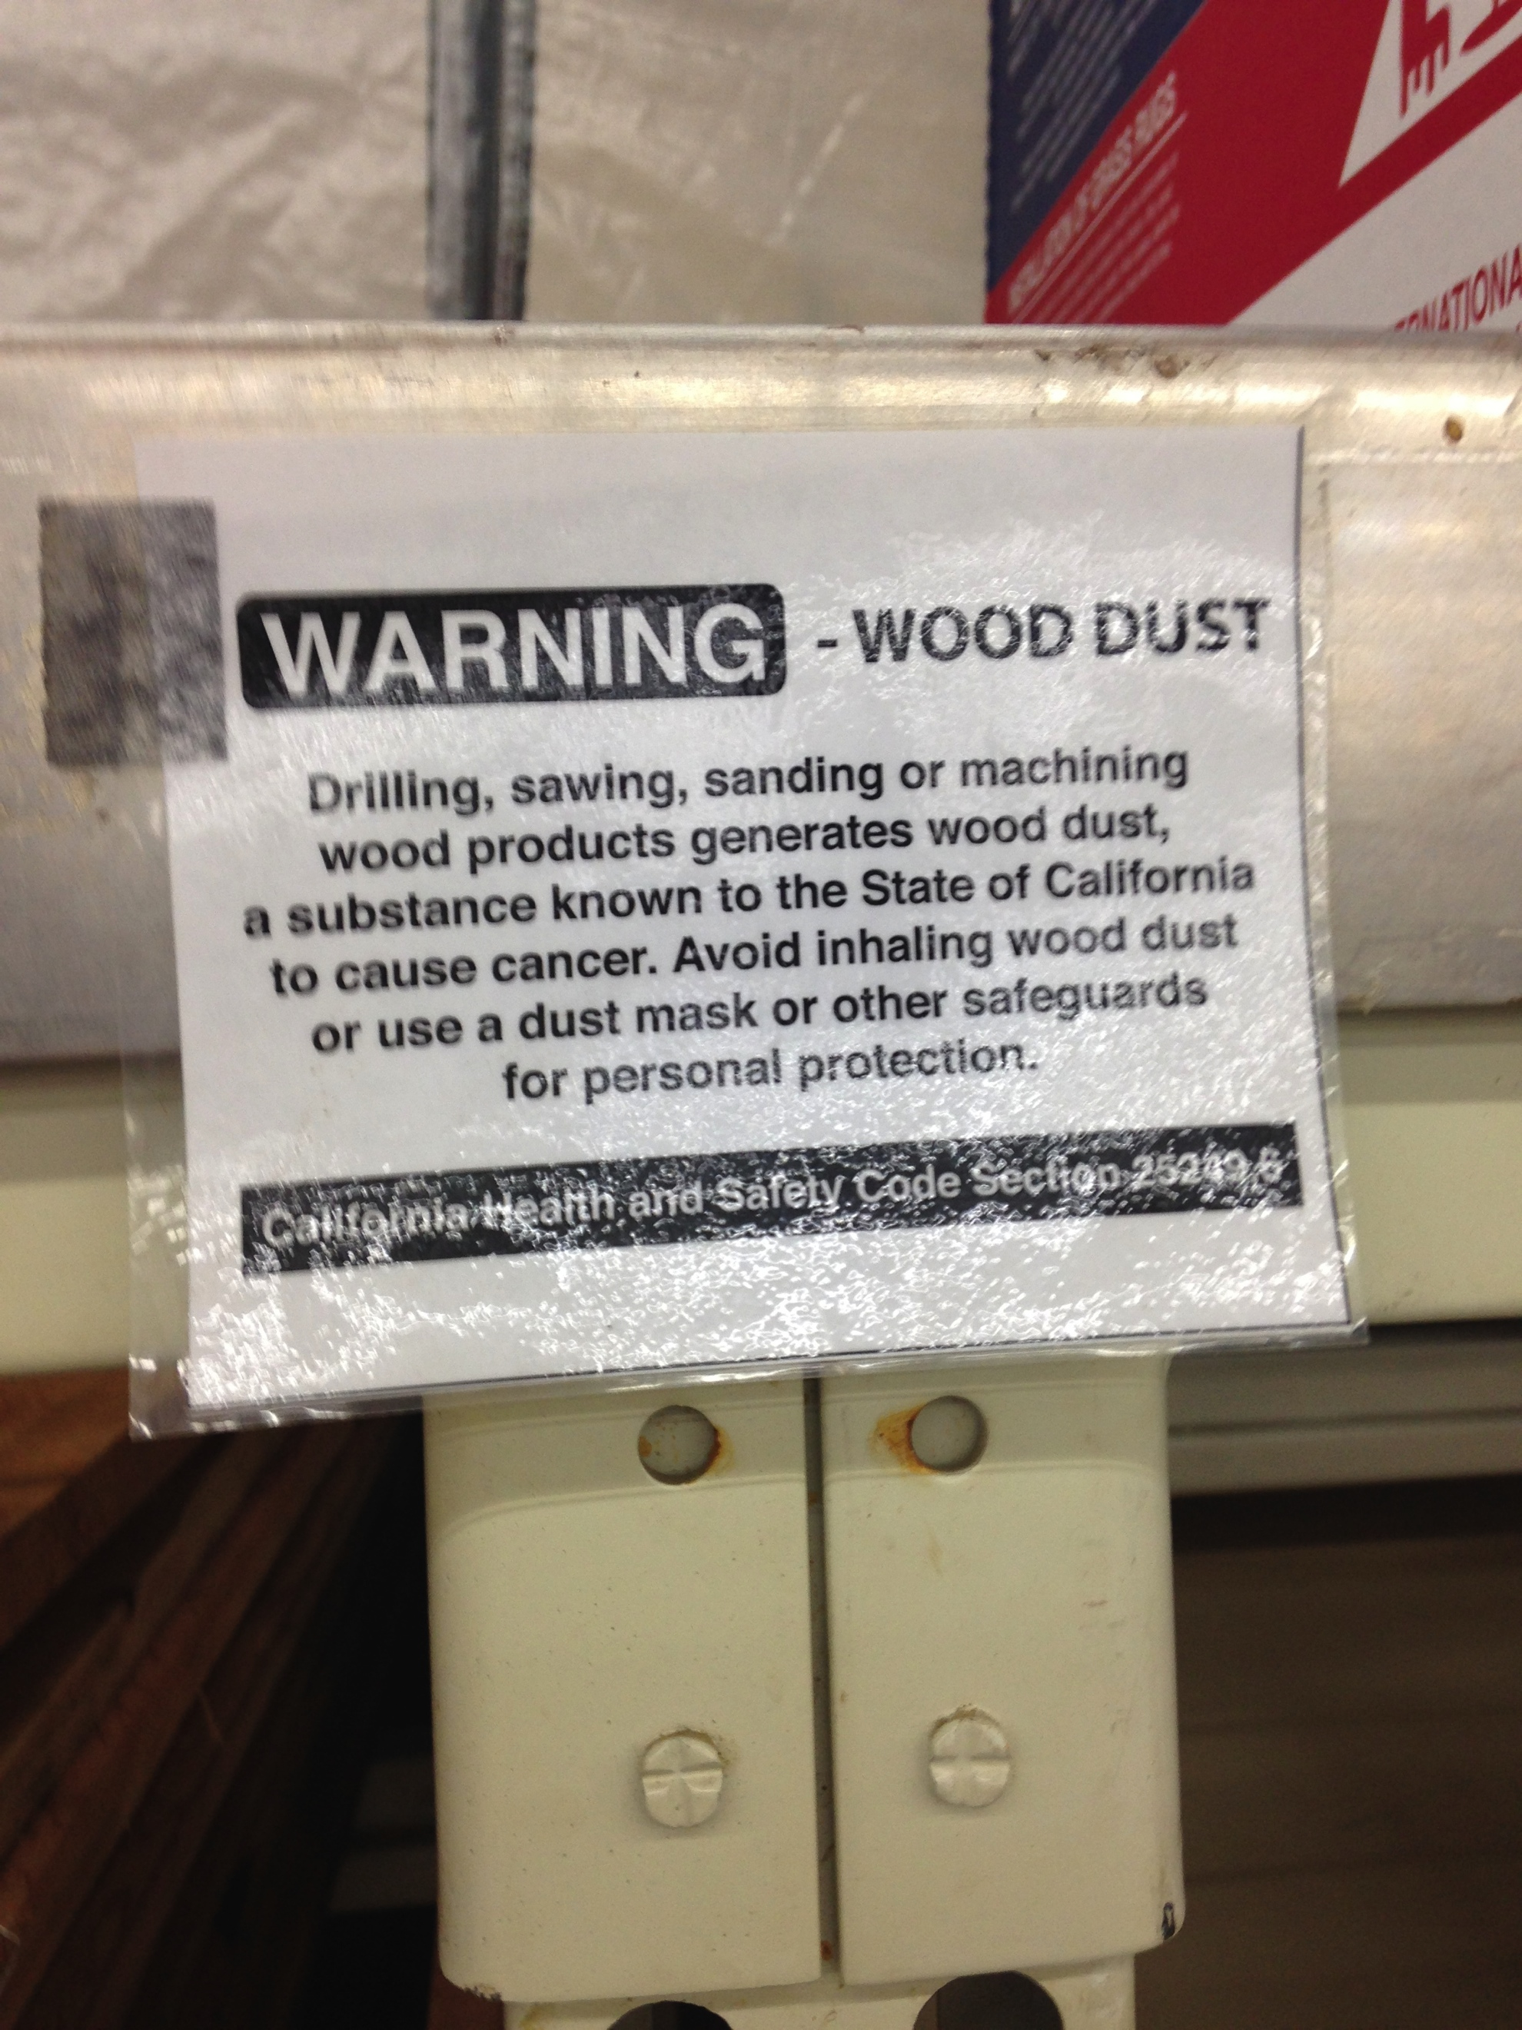
Notes:
Ben

Slide 9
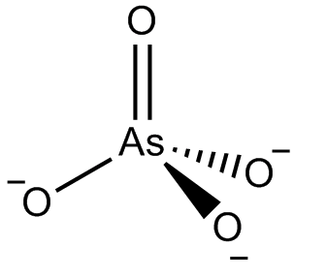
TOXINS in “CCA”
CHROMIUM
COPPER
ARSENATE
AsO₄3−
Notes:
BEN

Slide 10
NATURAL FORM of Arsenate
Arsenic is a chemical element and is a natural constituent of the Earth's crust. It occurs naturally in rocks and soil, water, air, and plants and animals. When in the natural environment, arsenic usually binds to other molecules, such as those found in soils, and does not tend to travel very far. The average concentration of arsenic in soils in the United States varies considerably. Arsenic can be released into the environment through natural occurrences such as volcanic activity, erosion of rocks, and forest fires, or through human actions.
Agricultural practices, mining, and smelting also contribute to arsenic releases in the environment.
Approximately 90 percent of industrial arsenic in the United States is currently used as a wood preservative, but it is also used in paints, dyes, metals, and semiconductors.

Slide 11
Arsenate poisoning
Arsenate can replace inorganic phosphate in the step of glycolysis that produces 1,3-bisphosphoglycerate from glyceraldehyde 3-phosphate. This yields 1-arseno-3-phosphoglycerate instead, which is unstable and quickly hydrolyzes, forming the next intermediate in the pathway, 3-phosphoglycerate. Therefore glycolysis proceeds, but theATP molecule that would be generated from 1,3-bisphosphoglycerate is lost - arsenate is an uncoupler of glycolysis, explaining its toxicity.^{[2]}
As with other arsenic compounds, arsenate can also inhibit the conversion of pyruvate into acetyl-CoA, blocking the Krebs cycle and therefore resulting in further loss of ATP

Slide 12
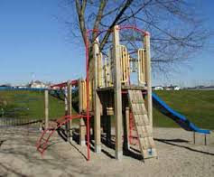
Where is it commonly found
Playground equipment
Deck
Fences
Boat dock
Gazebo
Walkways
Desks
WOOD FRAME STRUCTURES, shingles, industrial
Notes:
Ben

Slide 13
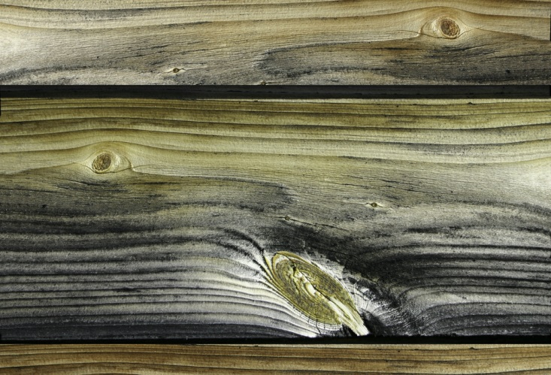
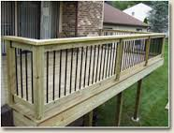
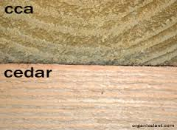
Notes:
Ben

Slide 14
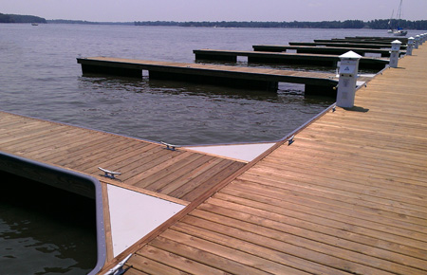
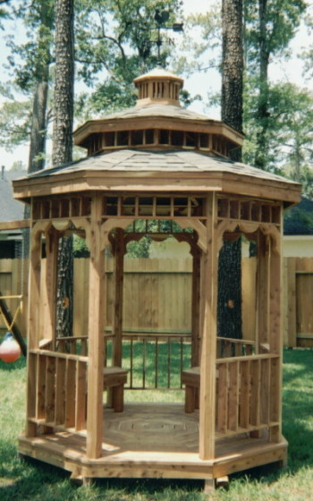
Notes:
Ben

Slide 15
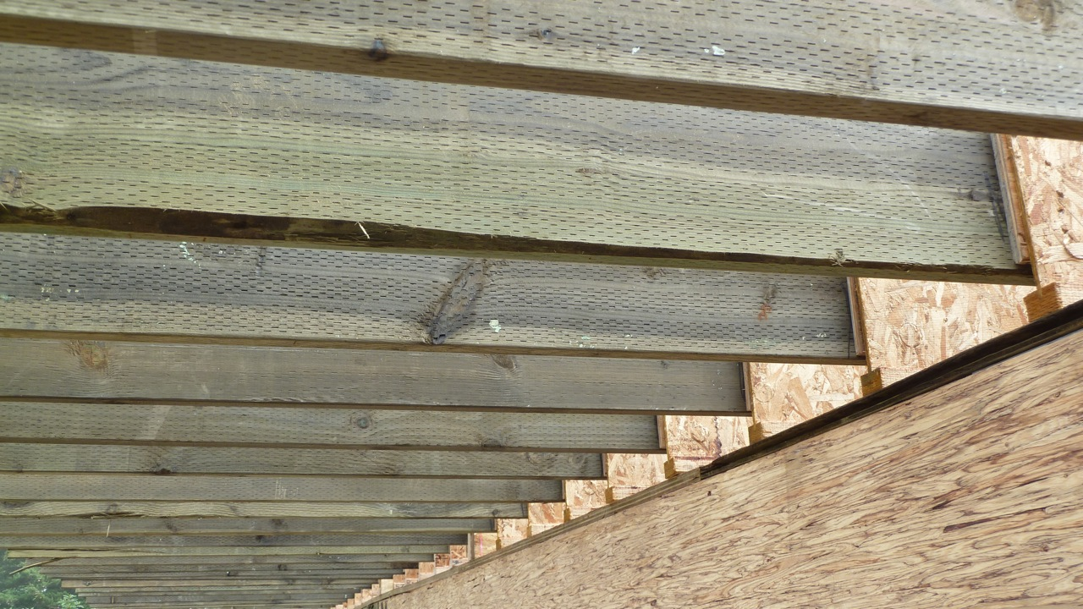
Notes:
Ben

Slide 16
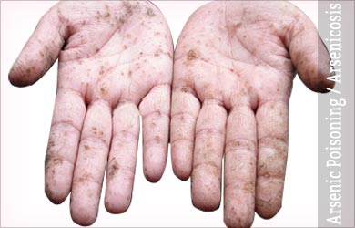
HOW INDIVIDUALS ARE EXPOSED
Direct contact
Contaminated soil
Incomplete fixation
Food grown in contaminated soil
Inhalation

Slide 17
Target organs
GI TRACT: For soluble trivalent arsenic compounds, approximately 95% of the ingested dose is absorbed from the gastrointestinal
LUNG: Airborne arsenic in the workplace is generally in the form of arsenic trioxide [Ishinishi et al. 1986].
The amount of arsenic absorbed by inhalation has not been determined precisely, but it is thought to be within 60% to 90% [Yip and Dart 2001].
Smaller particles are deposited more deeply in the respiratory tract.
DERMAL: Dermal absorption is generally negligible, although toxic systemic effects have resulted from rare occupational accidents where either arsenic trichloride or arsenic acid was splashed on workers' skin.
After absorption through the lungs or GI tract, arsenic is widely distributed by the blood throughout the body. [ATSDR 2007]
Most tissues rapidly clear arsenic, except for skin, hair, and nails [Lansdown 1995].
Two to four weeks after exposure ceases, most of the arsenic remaining in the body is found in keratin-rich tissues such as
hair,
cardiovascular
Liver
Kidney
nails, skin, and to a lesser extent, in bones and teeth [Yip and Dart 2001].
Notes:
Ben

Slide 18
MECHANISM OF ACTION AND TARGET ORGAIN OF INJURY
Cardiovascular
Diabetes (chronic)
Neurological
Oncogenicity
Dermatitis
Notes:
Ben

Slide 19
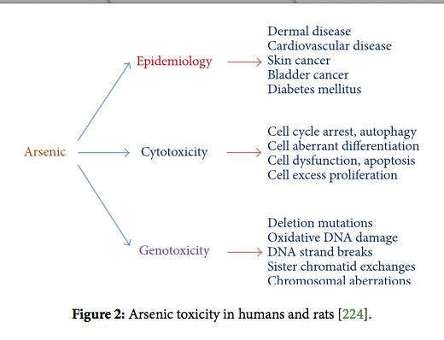
Notes:
Ben

Slide 20
DOSE-RESPONSE FOR TOXIC ACTION AND INJURY
1mg/kg body weight per day
Notes:
SMALL amounts of Arsenic are REQUIRED for normal operation of the body. However, larger doses can be fatal. An ACUTE FATAL DOSE of Arsenic is in the range of 2-20mg/kg body weight/day. Thus, a relatively healthy person who weight 160lbs, about 72.6kg, may die if he ingests between 0.145gm and 1.45gm Arsenic in the form of Arsenic Trioxide, As₂O₃. i.e. 0.192gm to 1.92gm of Arsenic Trioxide.

Slide 21
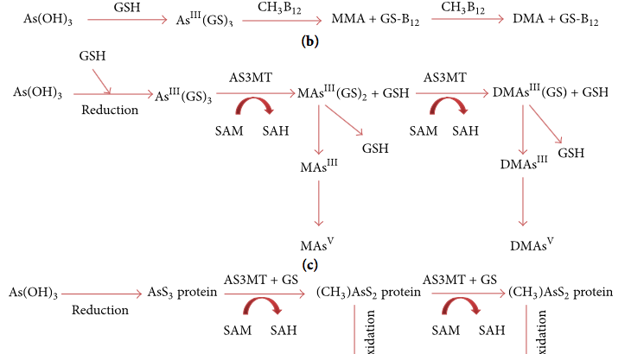
HOW IS THE TOXIN METABOLIZED AND ELIMINATED FROM THE BODY
Notes:
Figure 1: Pathways of arsenic metabolism in cells: (a) arsenic methylation in Scopulariopsis brevicaulis [54], (b) nonenzymatic As methylation in rat liver [55], (c) arsenic metabolic pathway in rat liver [56], and (d) metabolic pathway in rat liver [58], where SAM: S-adenosylmethionine; SAH: S-adenosylhomocysteine; : methyl group; GSH: glutathione; (CH₃)(OH)₂AsO⁻: monomethylarsonous acid; (CH₃)₂(OH)AsO⁻: dimethylarsinic acid; (CH₃)₃As: trimethyl arsine oxide; As (GS)₃: arsenic triglutathione; MMA: monomethylarsonic acid; DMA: dimethylarsinic acid; M (GS)₂: monomethylarsonic diglutathione; DM (GS): dimethylarsinic glutathione; DM: trivalent monomethylarsonous acid; DM: pentavalent dimethylarsinic acid; : pentavalent monomethylarsonic acid [224].

Slide 22
Biological half life
The half-life of inorganic arsenic in humans is about 10 hours [Rossman 2007]

Slide 23
Risk of exposure and how prevalent is the exposure to the public.
Wood Structures
Landscaping Structures (retaining walls, fence posts)
Raised bed gardens (Bad Bad Bad)
Notes:
Ben

Slide 24
CARE MANAGEMENT/ REUCE THE RISK FROM EXPOSURE
Saw, sand, and machine CCA-treated wood outdoors. Wear a dust mask, goggles, and gloves.
Clean up all sawdust, scraps, and other construction debris thoroughly and dispose of in the (i.e., municipal solid waste). Do not compost or mulch sawdust or remnants from CCA-treated wood.
Do not burn CCA-treated wood, as toxic chemicals may be released as part of the smoke
After working with the wood, wash all exposed areas of your body, especially the hands, thoroughly with soap and water before eating, drinking, toileting, or using tobacco products.
Wash your work clothes separately from other household clothing before wearing them again.
Homeowners should never burn CCA-treated wood or use it as compost or mulch. CCA-treated wood can be disposed of with regular municipal trash

Slide 25
Summary
CCA poses significant risk to human health.
Use caution in use and disposal of CCA pressure treated wood.
Use alternative woods like redwood, cedar, teak, and sustainably harvested exotic woods.
Notes:
Ested

Slide 26
Bibliography
Chromated Copper Arsenate (CCA) Treated Wood http://www.beyondpesticides.org/infoservices/pesticidesandyou/spring%2003/cca%20factsheet.pdf
Arsenic Poisoning / Arsenicosis http://www.medindia.net/patients/patientinfo/arsenic-poisoning.htm
Arsenic Poisoning
http://chemsee.com/poison-detection/poison-detection-resources/chemnote-arsenic-poisoning/
Arsenic toxicity, what is the biological fate of arsenic in the body http://www.atsdr.cdc.gov/csem/csem.asp?csem=1&po=9

Slide 27
Bibliography cont.
Alternative in pressure treated wood http://www.ccaresearch.org/ccaconference/pre/pdf/lebow.pdf
How does pressure-treated lumber work? http://home.howstuffworks.com/home-improvement/remodeling/question278.htm
Arsenic in Pressure Treated Wood http://www.ct.gov/caes/cwp/view.asp?a=2824&q=378050
PROJECT SUMMARY SHEET http://www.ccaresearch.org/propy4.htm
Cromated copper arsenate treated wood http://www.beyondpesticides.org/infoservices/pesticidesandyou/spring%2003/cca%20factsheet.pdf
EPA http://www.epa.gov/oppad001/reregistration/cca/cca_qa.htm

